Slide 1

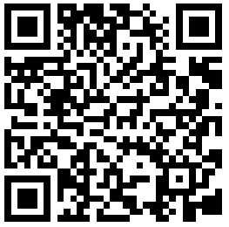
CS2113/T – Lecture 7
Go to:
*github.com/nus-cs2113-AY2021S2/Utilities
Fork to your GitHub account
Clone the fork to your computer
Set up the project in IDE
Ensure it is setup as a Gradle project
Also, join the session: http://pollev.com/anarayan
This lecture will be recorded
This lecture will be recorded
Archipelago session
* Reusing from previous semester

Slide 2

Recap
Streams vs Collections
Workflow – PR, merging, syncing updates
Javadoc
Codequality
CI

Slide 3
Activity: Inspect CI
build.gradle file – in the repo
gradle.yml file – on GitHub (tP)

Slide 4
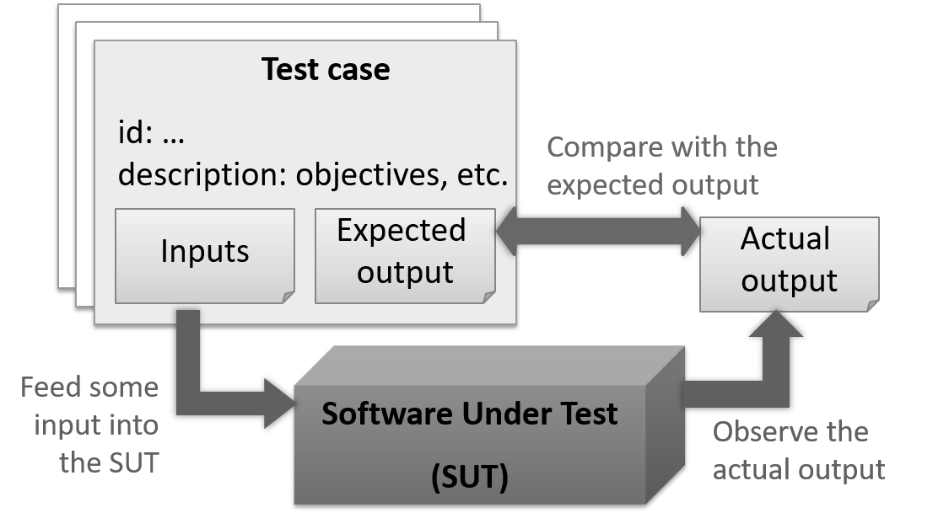
Testing
____?____
Q: What does SUT stand for A: Software under test

Slide 5
QA testing the full system
SUT
QA

Slide 6
Developer testing

Slide 7
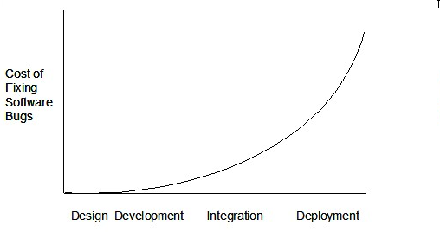
Later a bug is found, costlier it is to fix!

Slide 8

[Extra] who wants maximum publicity
Do you want maximum publicity for your mistakes?
Early developer testing is very important

Slide 9
Unit Testing: Testing smaller parts in isolation
SUT== MSLogic
UI
MSLogic
History
Storage

Slide 10
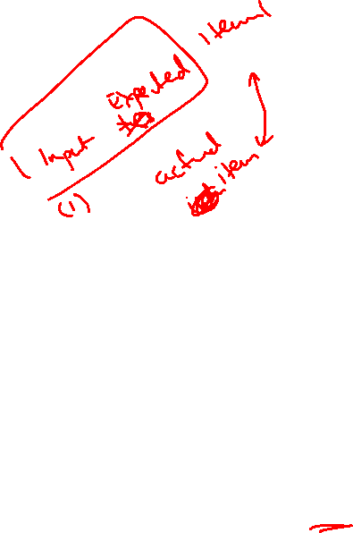
Test automation
Test Driver
SUT== MSLogic
UI
MSLogic
History
Storage
String item = msLogic.getItem(1);
if(!item.equals(“Item1”) print(“Case 1 failed”);
…

Slide 11

Test automation
Test Driver
SUT== MSLogic
UI
MSLogic
History
Storage
String item = msLogic.getItem(1);
if(!item.equals(“Item1”) print(“Case 1 failed”);
…

Slide 12
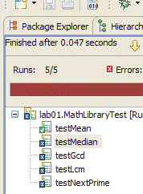
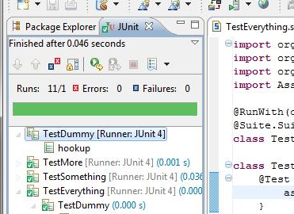
String item = msLogic.getItem(1);
if(!item.equals(“Item1”) print(“Case 1 failed”);
…
Testing frameworks
assertEquals(“Item1”, msLogic.getItem(1));
JUnit

Slide 13
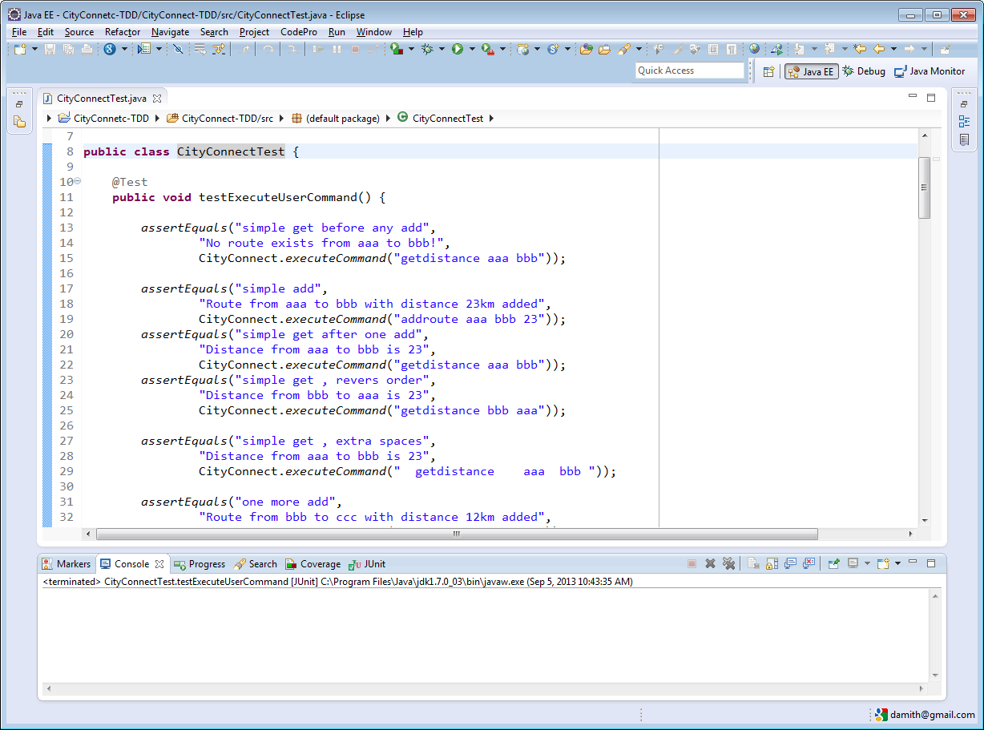
Annotation

Slide 14
Annotation
c
a
b
(1) One is the test input,
(2) One is the actual output,
(3) One is the expected output.

Slide 15
Annotation
c
a
b
(1) One is the test input,
(2) One is the actual output,
(3) One is the expected output.
a
b
c

Slide 16
Annotation

Slide 17
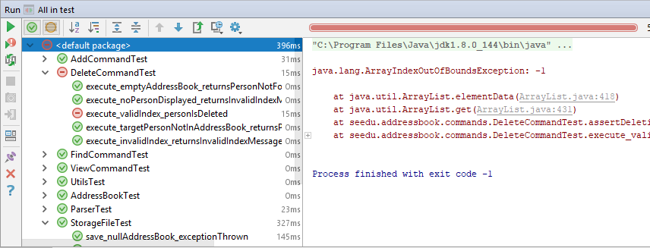

Slide 18
Activity: JUnit
Add some tests to the StringParser#splitString method

Slide 19

Admin matters
TP information videos $→$ Watch them!
Mid semester survey results

Slide 20
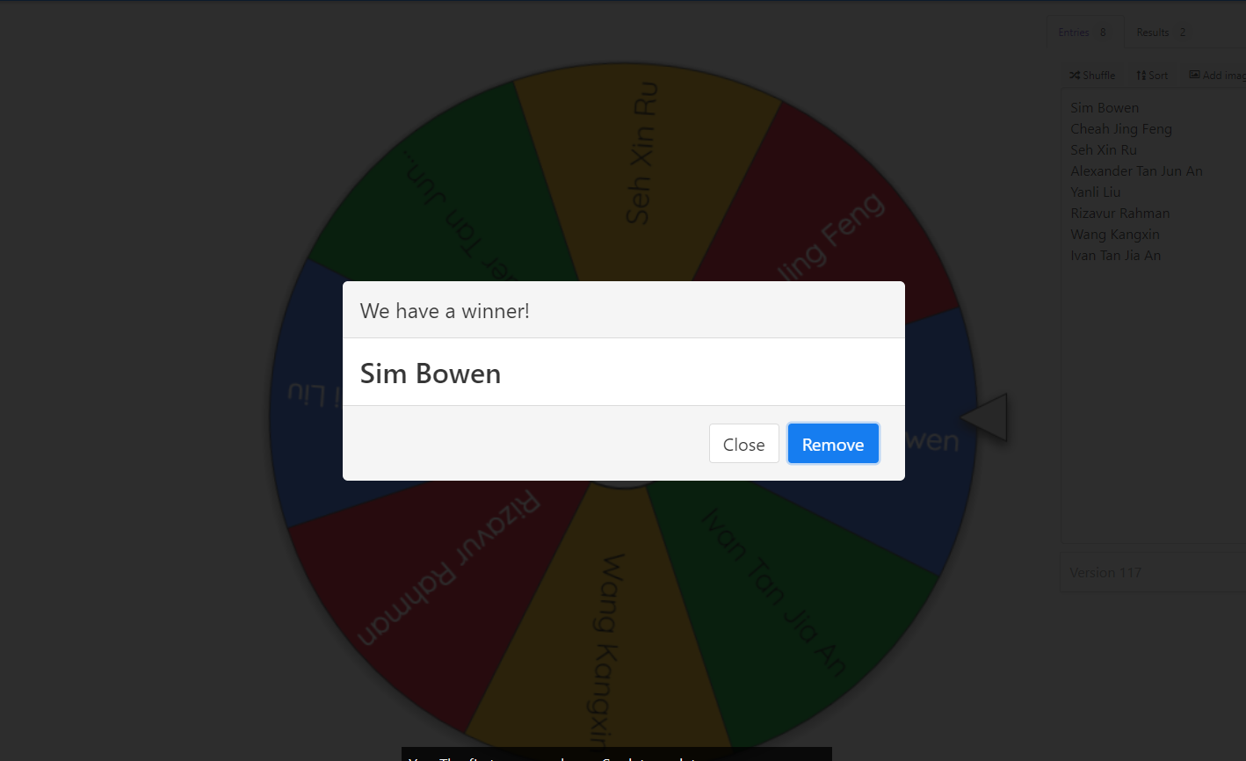
Spin the Wheel

Slide 21
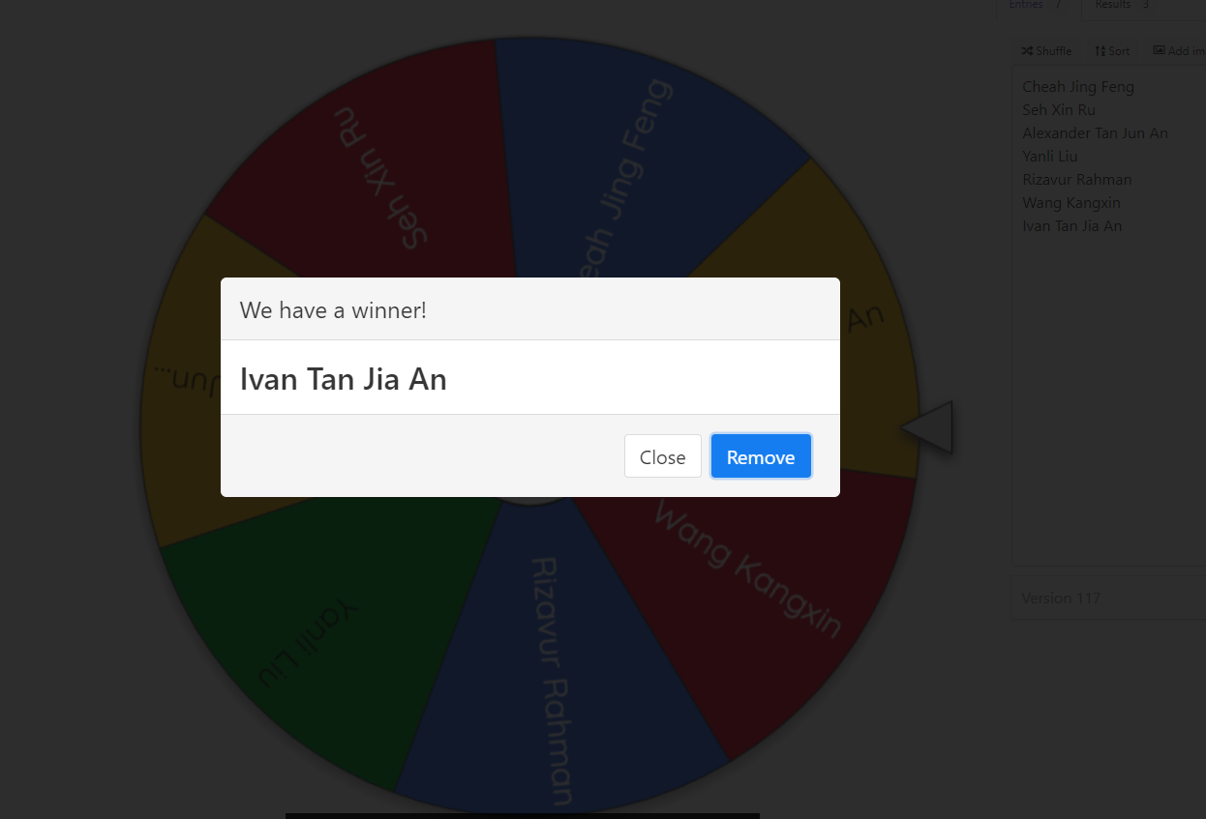
Spin the Wheel

Slide 22
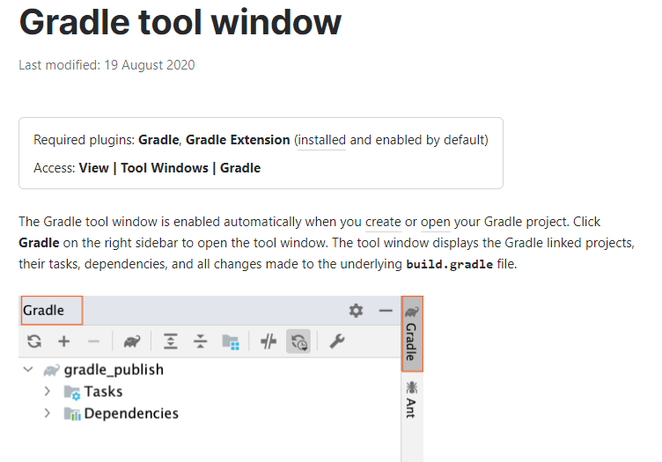
Activity: Run checkstyle
Using IDE run checkstyle
On the terminal/command prompt:
[*nix] ./gradlew checkstyleMain
[Win] gradlew checkstyleMain

Slide 23
Demo: Bug report Demo: Project scheduling & tracking
Inspect the issue tracker labels & Create label
Inspect milestone & Create milestone
Issue management for failing checkstyle
Assign appropriate label & milestone
Fix issue in a branch & push
PR to master with Fixes #<issue number>

Slide 24
Name
name: String
Person
numPersons: int
getNumPersons():int
Address
lives here
home
Associations
Connections between classes/objects
Phone
number: String
Labels
Describe the meaning
Role
Role played by the object in the association
Navigability
Which class knows about the other

Slide 25
Name
name: String
alias
Person
+ numPersons: int
+ getNumPersons():int
given name
*
1
Address
lives here
home
hand phone
Phone
- number: String
Default is 0 .. 1
Multiplicity
How many objects are involved

Slide 26
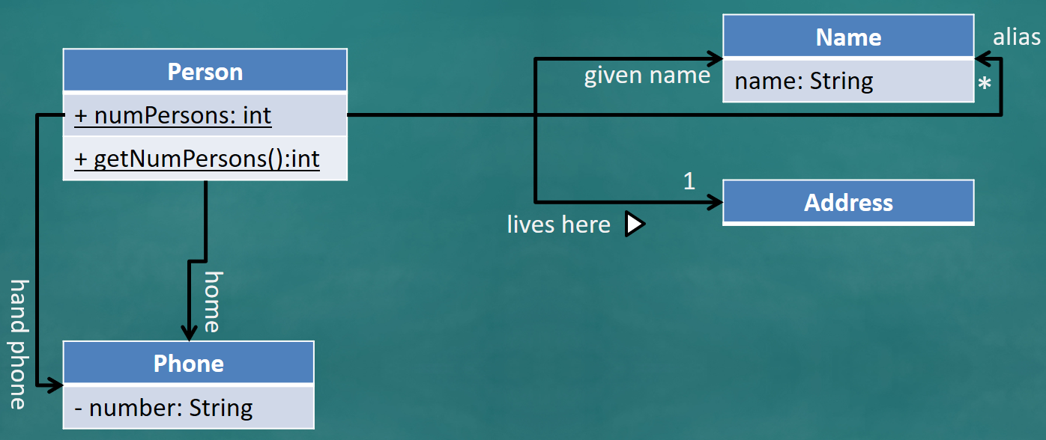
class Name {
String name;
...
}
class Address {
String address;
public Address(String address) {
this.address = address;
}
}
class Person {
Name givenName;
Name [] aliases; // can be ArrayList ...
Phone homePhone;
Phone handPhone;
Address homeAddress;
public static int numPersons = 0;
public static int getNumPersons() { ... }
...
}
class Phone {
private String number;
public String getNumber() { ... }
...
}

Slide 27
What happens when a person is created in the system?
:Person
homeAddress:Address
Is this a valid state?

Slide 28
Set the given name to be John Doe
John Doe is also called JJ by his friends
John Doe is also called JD in his office
givenName:Name
class Person {
Name givenName;
Name [] aliases; // can be ArrayList ...
Phone home;
Phone handPhone;
Address homeAddress;
public static int numPersons = 0;
public static int getNumPersons() { ... }
...
}
name = “John Doe”
:Person
homeAddress:Address
alias:Name
name = “JJ”
alias:Name
name = “JD”

Slide 29
JJ changed his home address to a different address, address2
givenName:Name
Associations in the object structure can change over time
address2:Address
name = “John Doe”
:Person
homeAddress:Address
alias:Name
name = “JJ”
alias:Name
name = “JD”

Slide 30
Developer documentation
For developer as a maintainer
Make it comprehensible rather than comprehensive
Explain the design – use UML
Include your design decisions

